Slide 1
Exercises
Analysis of protein stretching experiments

Slide 2
Preparations
Create a working folder on your computer
For experimenting
Create a separate folder for the Matlab files
Download files to this folder from GitHub:
https://github.com/are-mj/OpticalTweezers
In Matlab:
cd to the working folder
Add the Matlab files folder to the Matlab path
addpath <folder path>
On my PC:
cd C:\Users\are\OneDrive\Chile\Summer_school
addpath C:\Users\are\OneDrive\Documents\GitHub\OpticalTweezers

Slide 3
Experiment files
Create a datafolder for the experiment data files and COM files that you received by mail.
Save the files either directly to the Datafolder or create a subfolder for storing the files (e.g. ‘summerschool’)
In Matlab:
Create datafolder.m to point to the Datafolder (next slide)

Slide 4
Create datafolder.m
The file datafolder_template.m returns a sample folder path:
function folder = datafolder_template
% Template for the user's datafolder.m
folder = 'C:\Users\Are\OneDrive\Data\Chile’;
Change the folder path to your data folder and delete ‘_template’ from the function name.
Save as datafolder.m

Slide 5
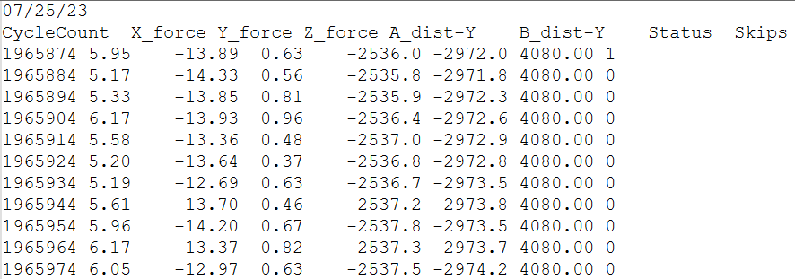
Experiment data file
seconds*4000
Use mean of trap positions A and B
(minus) Force (pN)
(minus) Trap pos. A
(minus) Trap pos. B
Temperature code

Slide 6
Reading an experiment file
[t,f,x,T] = read_experiment_file(file);
[t,f,x,T] = read_experiment_file('aA.txt');
Inputs:
file: aA.txt, folder1/Aa.txt or full path and filename
Outputs:
t: Time (seconds since experiment start)
f: Pulling force (pN)
x: Trap position (nm)
T: Temperature (˚C)

Slide 7
Toolboxes needed
Optimization toolbox
Signal processing tb.
Statistics and machine learning tb.

Slide 8
Exercise 1 A: Finding rips and zips
Use read_experiment_file to read one experiment file
Create plots of f(t) and x(t) as subplots in the same figure:
figure; tiledlayout(2,1);
ax1 = nexttile; plot(t,f); xlabel s; ylabel pN
ax2 = nexttile; plot(t,x); xlabel s; ylabel nm
linkaxes([ax1,ax2],'x') % Couple zoom and pan in both axes
Try to locate the first few rips and zips
Note the approximate times and force values

Slide 9
Exercise 1 B
Run analyse_experiment for the same experiment file
Make sure to set input ‘plotting’ to 1:
[Trip,Tzip] = analyse_experiment(file,1);
Use the datacursor symbol in the axes toolbart o read the x and f vales for the zip
Do the automatic rips and zips agree with yours?
If not, comment on who is probably right, and why.

Slide 10
Exercise 1 C: Δx and force shift
Zoom to one cycle having both a rip and a zip
Create variables t1 and t2 for the times for the valley on each side
Use the datacursor tool to see the times
Create logical array ok which is true only between t1 and t2
ok = t > t1 & t < t2;
figure; plot(x(ok),f(ok))
Estimate Δx for the rip and the zip
Tip: Use the datacursor tool
Estimate the force shifts

Slide 11
Exercise 1 D: Matlab tables
Find the row in Trip that corresponds to the rip that you estimated Δx and force shift for. How do your estimates compare with the values found automatically?
Possible reasons for any differences?

Slide 12
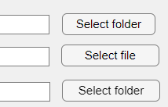
The RipAnalysis app
You can start the app from Matlab’s Command window
Simply type
RipAnalysis
Specify folders and file
Use the buttons to browse, or paste text into the text boxes
The data file name may contain a subfolder name
The Output folder may be the same as the Data folder
Not recommended if you are sharing the data folder with others

Slide 13
Exerise 2: The RipAnalysis app
In this exercise we want you to use the app to go through a few experiment files
Inspect the automatically identified rip and zip events
Remove any incorrect event
Add any missing events
Store results tables Trip and Tzip
The next two slides show how to remove and add events

Slide 14
Exercise 2: Removing things
If Data folder and Data file are correct you should see a f(t) graph with rips and zips marked
Remove any disturbing data at start or end by clicking the Start or End buttons and use the crosshairs to specify new limits.
If crosshairs are very slow to react it may help to exit Matlab and start again.
To remove a rip/zip: Zoom in so that fewer than 20 rips and zips are visible. Then click the Remove rip/zip button and select one or more events to remove from the List box
Click the Save button to store Trip and Tzip tables
Notes:
Remove end: Files(1): 20230721/KC.txt Remove rip: 20230721/gA.txt (files(2))

Slide 15
Exercise 2: Adding a rip or a zip
Find an experiment with a missing rip
Or remove one or more rips that you can next put back
Zoom in close to the missing rip and click Add Rip/Zip
Use the crosshairs to specify the time of the rip
Click the Save button again
Notes:
20230724/qA.txt . Files(5)

Slide 16
Restore the original data
Mark and cut the file name in the file name text box (ctrl-x on Windows)
Click somewhere outside the text box to let Matlab register the change
Paste the file name back and click outside the text box
You will now see the original graph without your corrections
Restore your changes
The changes you made and stored are still available
Click “Recall saved changes” to retore your changes

Slide 17
Exercise 3: Preparations
In order to have enough data to work with, copy the contents of Summer school 2024/Testdata.zip to your Datafolder
In Matlab: files = [
"20230721/KC.txt"
"20230721/gA.txt"
"20230722/lC.txt"
"20230722/lE.txt"
"20230724/qA.txt"
"20230725/SB.txt"
"20230725/VA.txt"];
You may add your own file(s) to the list

Slide 18
Exercise 3: Fit model to data
Workflow:
Collect all analysis result tables into TRIP and TZIP
Select the subset you want to model (e.g. Temperature > 20)
Prepare the input to fit_Bell_unfold.m
Define initial values for the parameter vector
Calculate best fit parameters for the Bell model
Check that results look ok
If not, try with other initial values
See next slide for items 1 and 2
If you still have time: Try to fit the Dudko model
Compare parameters and standard deviations to the Bell model

Slide 19
Exercise 3 (continued)
To collect all analysis result tables into TRIP and TZIP
Create result tables for all the files:
[TRIP,TZIP] = analyse_many(files);
If you have made modifications in the app, do this instead
[TRIP,TZIP] = collect_tables(files);
Check the distributions of, say, Temperature and Pullingspeed:
figure; histogram(TRIP.Temperature,50)
figure; histogram(TRIP.Pullingspeed,50)
Select subsets:
ok = TRIP.Temperature>5 & TRIP.Fdot < 15;
See Fitting models to experiment.pptx for details about the remaining items.

Slide 20
Help needed!
The Matlab programs have a single author
Need new blood!
Two minds think better that one!
There are probably better ways to do many things
I am getting old!
Interested in helping with program development and maintenance?
Please contact Christian Wilson or me.
For my Email address, please type: contact_details in Matlab

Slide 21
Alternative experiment files
You may create another subfolder ‘testfiles’ to store the files in Testfiles.zip in the ‘Summer school 2024’ folder
I refer to some of those files on a few occasions, to make sure some files had relevant features. Probably we can find those features in the files you got by mail

